Slide 1
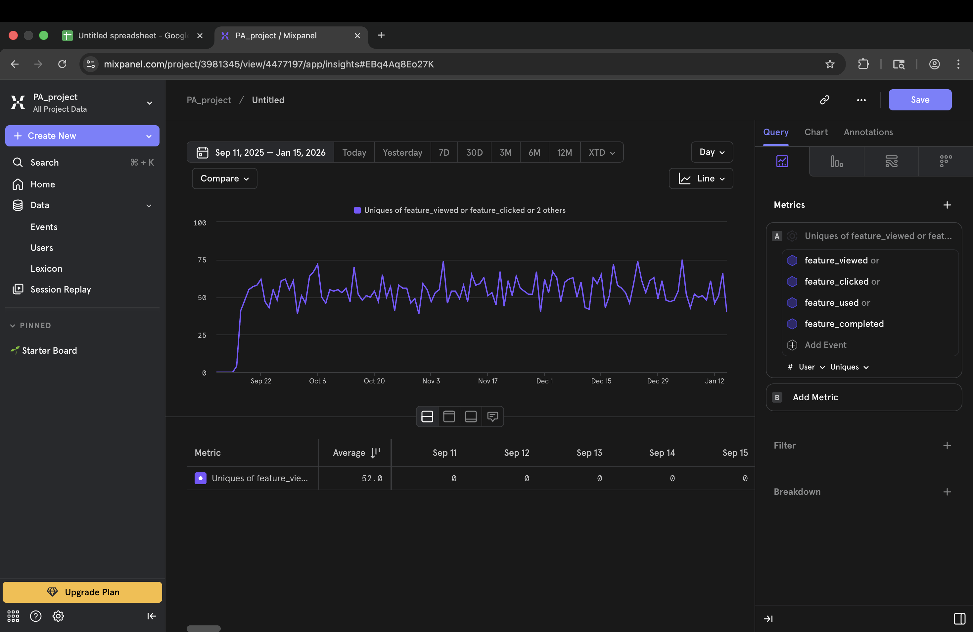
Daily Active Users

Slide 2
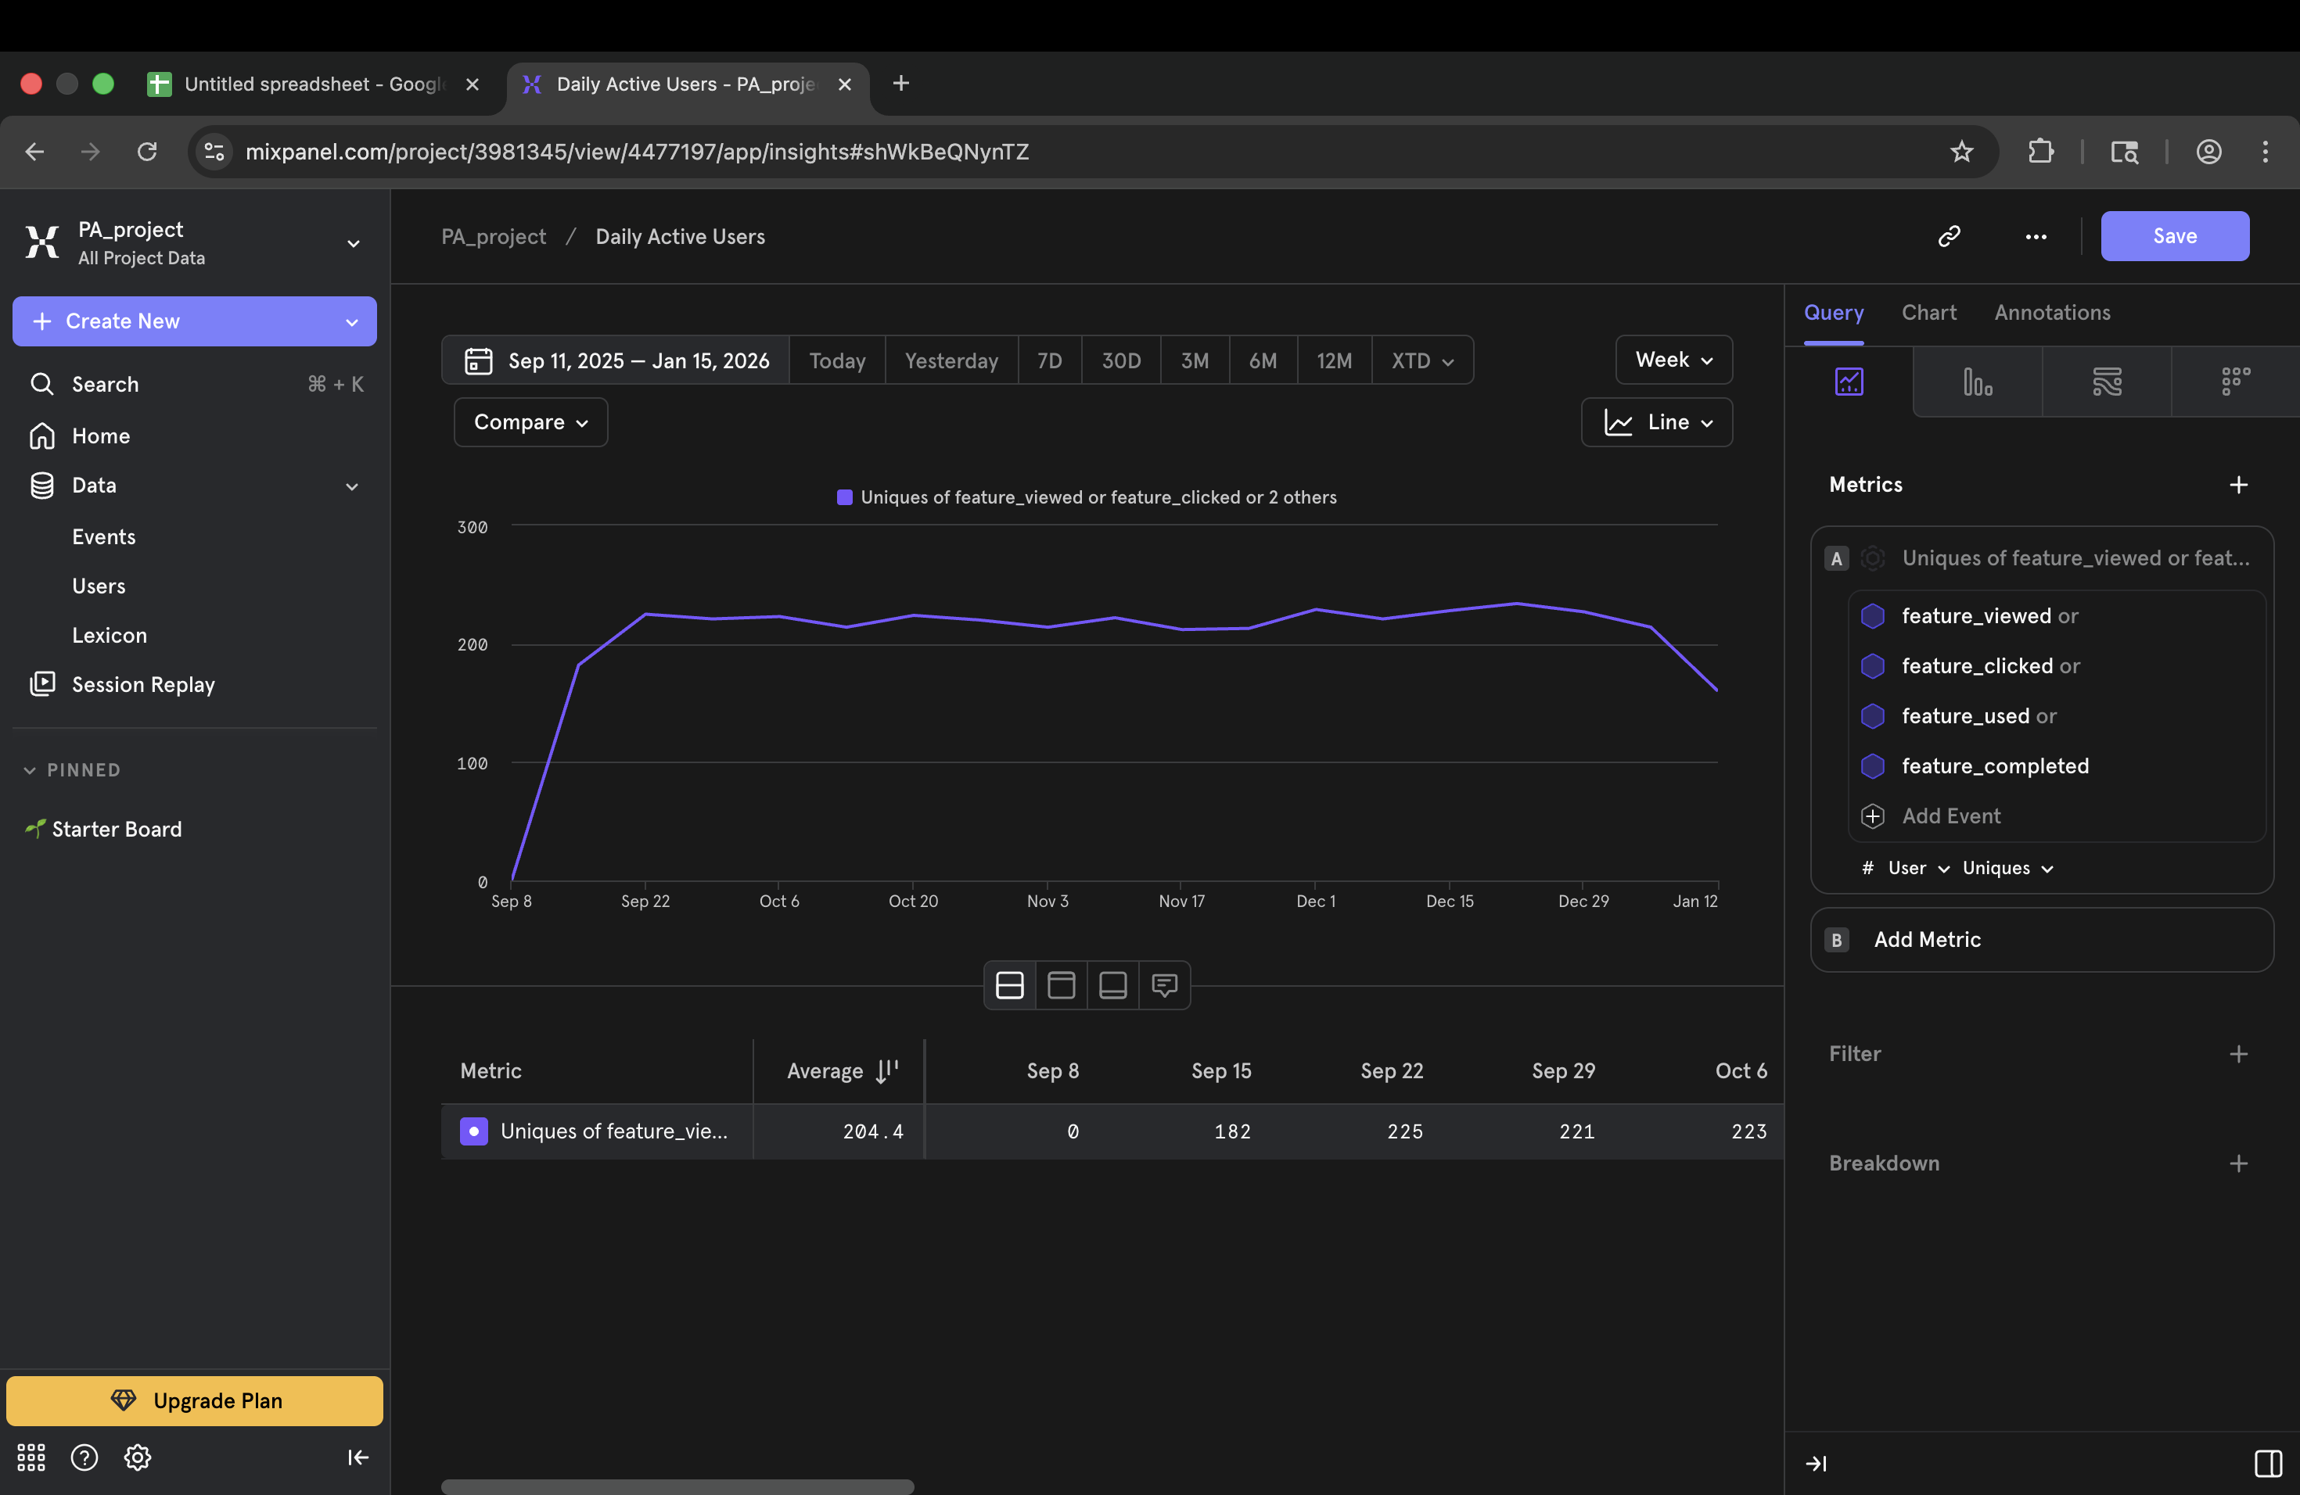
Weekly Active Users

Slide 3
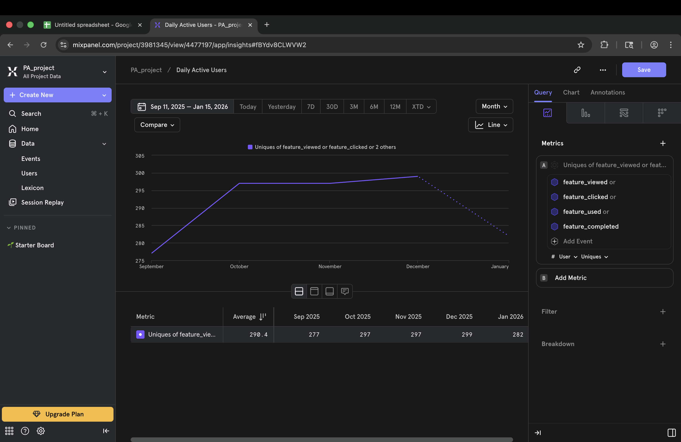
Monthly Active Users

Slide 4
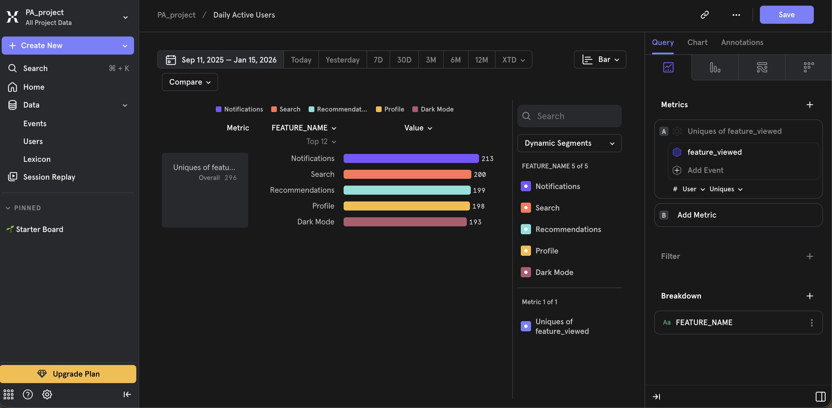
Feature Exposure (Discovery)

Slide 5
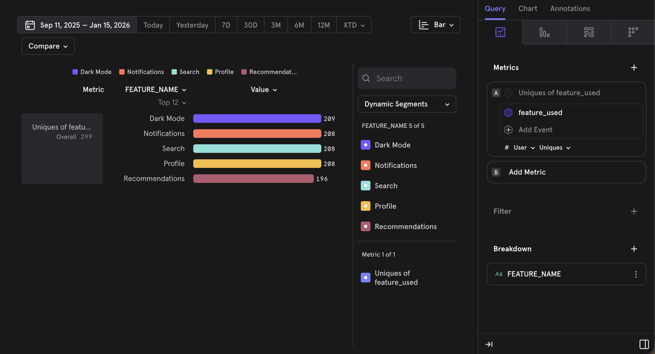
Feature Adoption

Slide 6
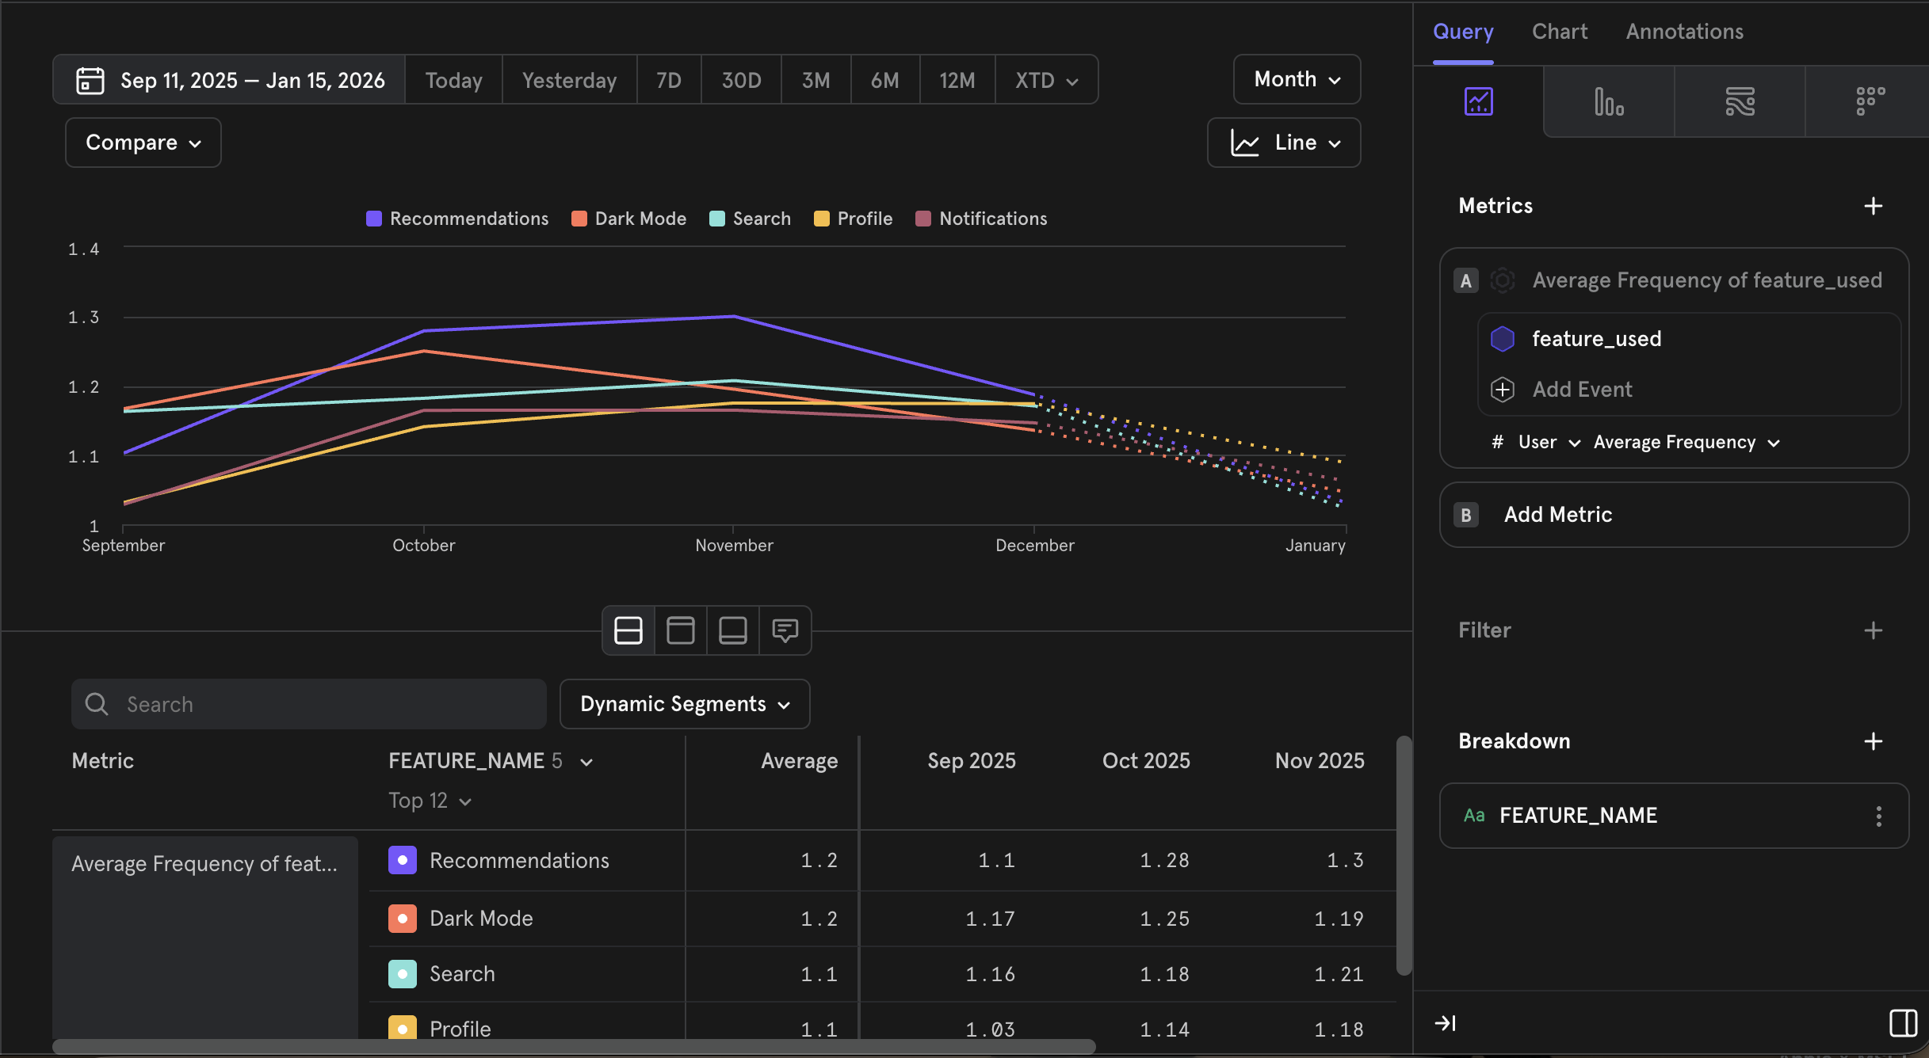
Feature Engagement

Slide 7
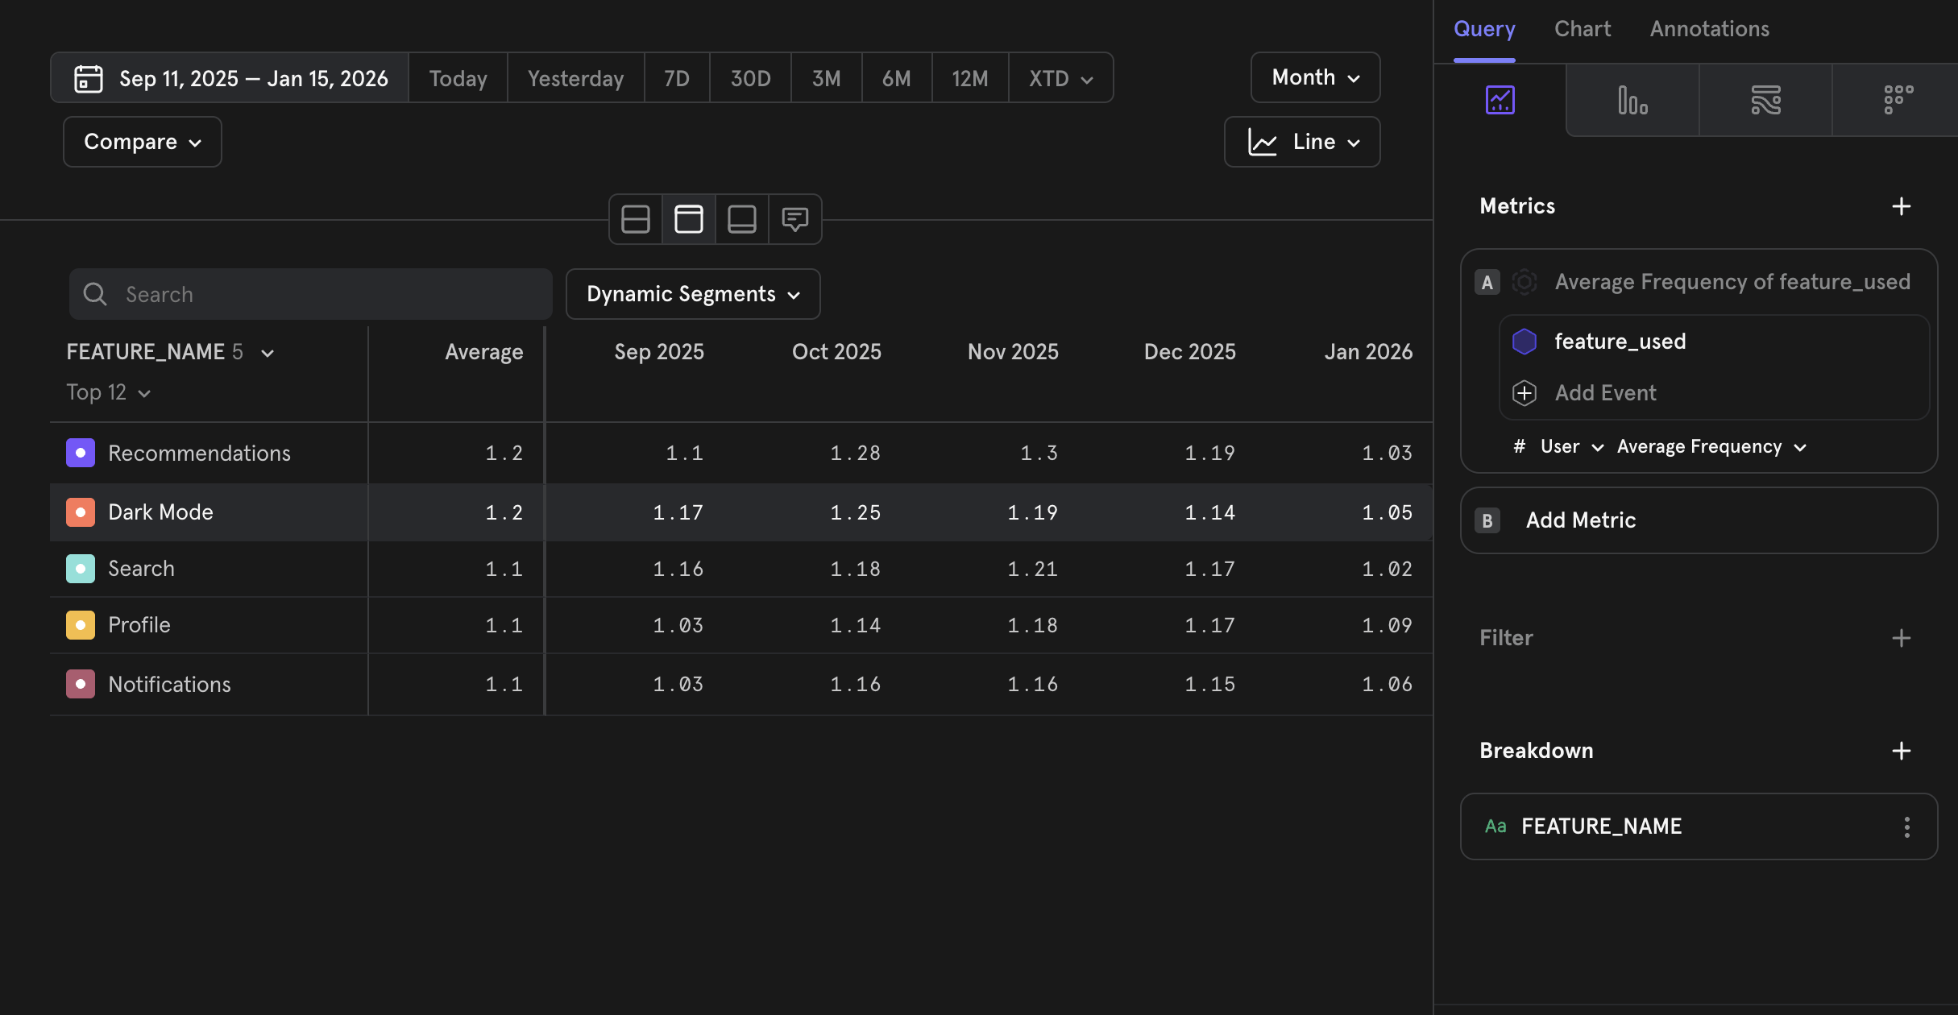
Feature Engagement

Slide 8
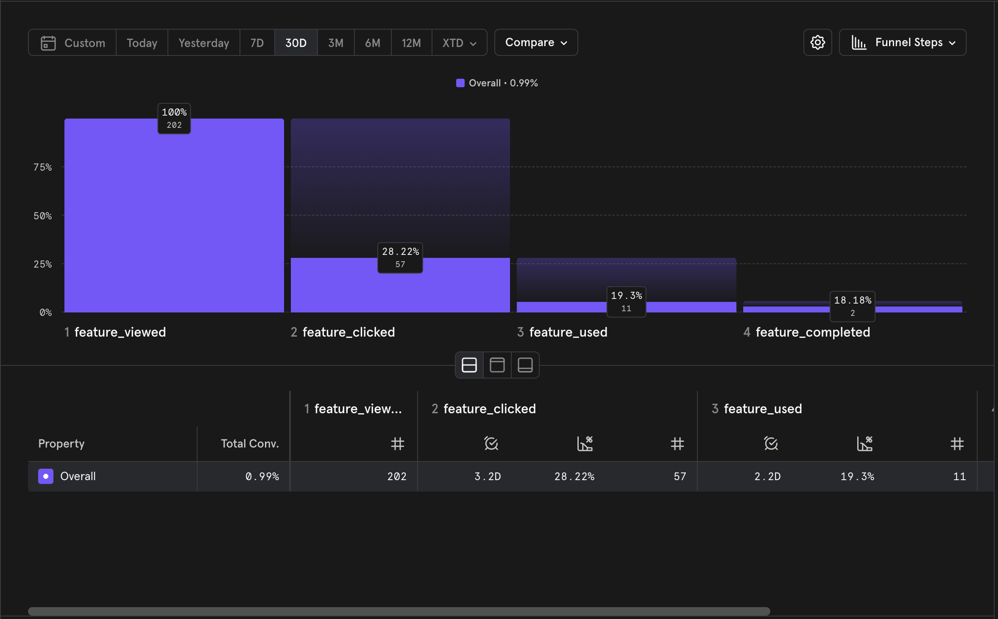
Feature Funnel

Slide 9
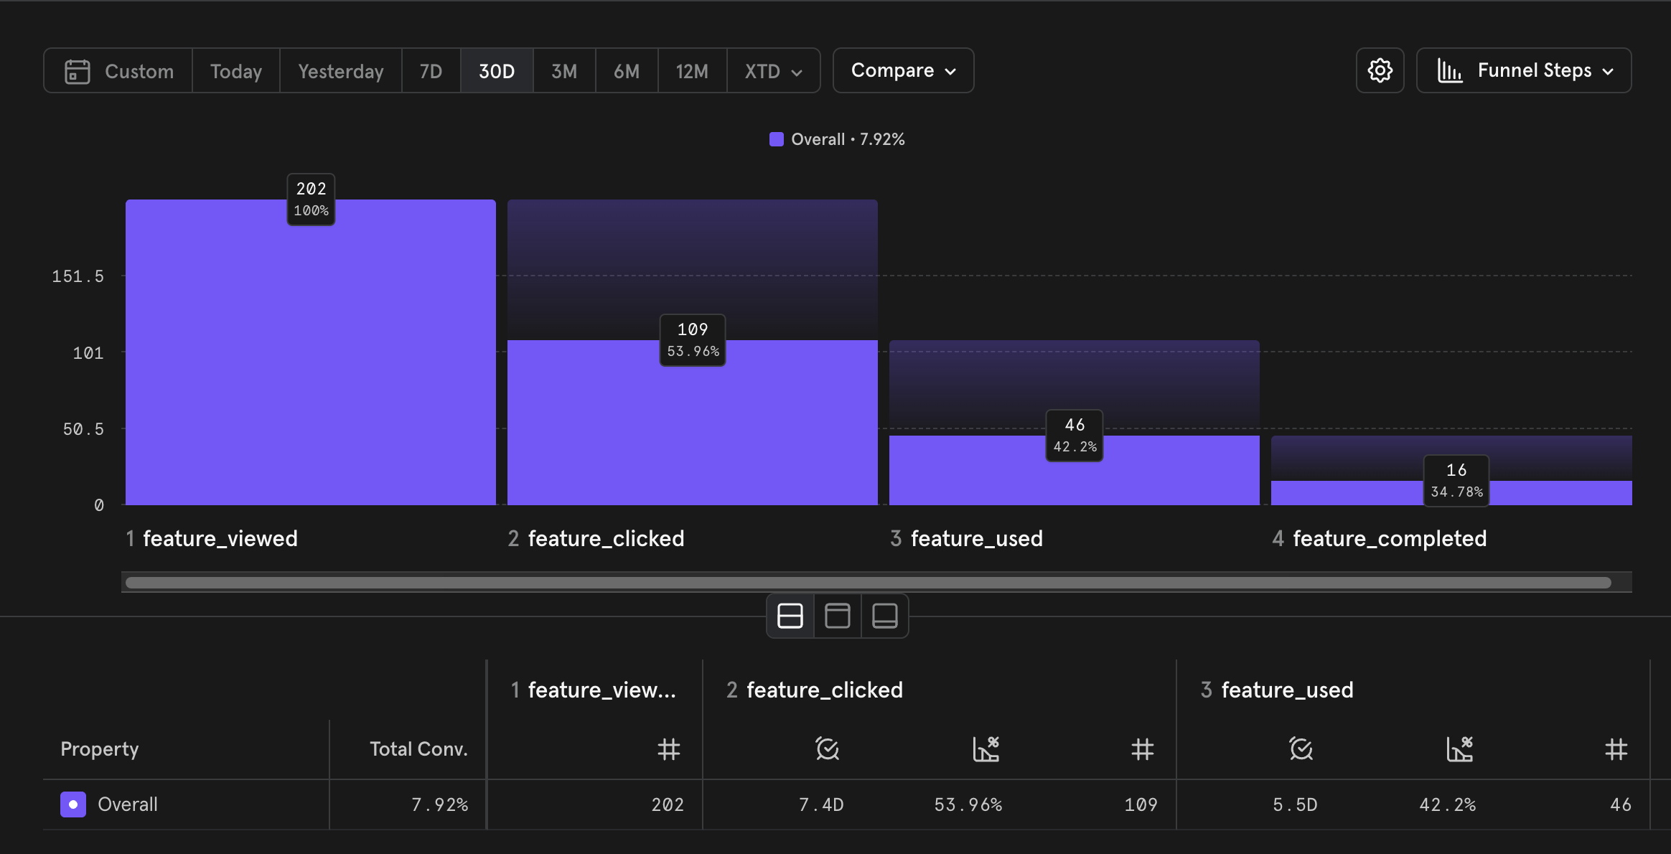
Feature Funnel : 30 Day window

Slide 10
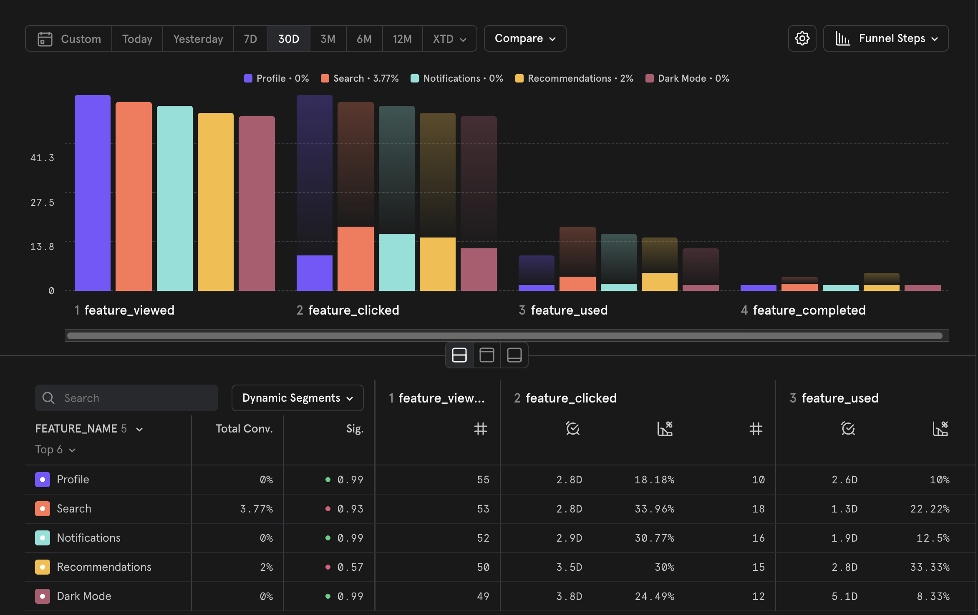
Feature funnel with breakdown – feature name

Slide 11
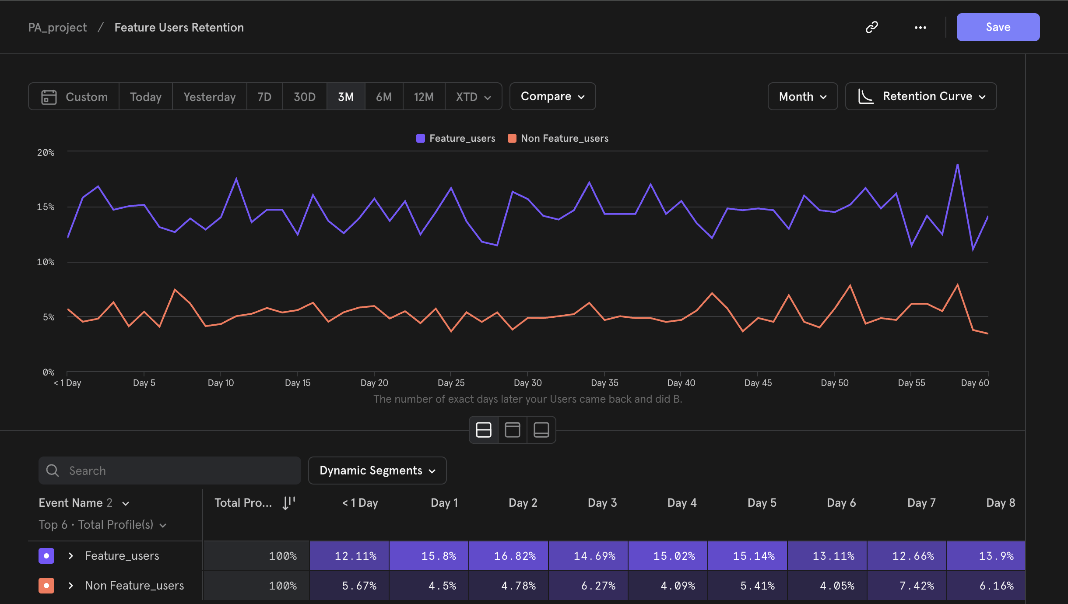
Comparison chart for Retention

